Slide 1

Optimizing disease progression rates in Lou Gehrig Disease(ALS)
University of Rochester
Team: Yonghao Duan, Xinxin Gu, Yuexi Wang, He Huang
Sponsor: Origent Inc.

Slide 2

Content
Background
Data Preprocessing
Exploratory Analysis
Modeling
Results and Conclusions
Next steps

Slide 3

Background —— Amyotrophic Lateral Sclerosis
heterogeneous
ALS
Live for 3 -5 years
How to evaluate it?
Limb/Bulbar onset
Speech
Salivation
Swallowing
Handwriting
Cutting food
……
12 Questions
ALSFRS-R
[0, 4] * 12 = [0, 48]
Notes:
kk

Slide 4
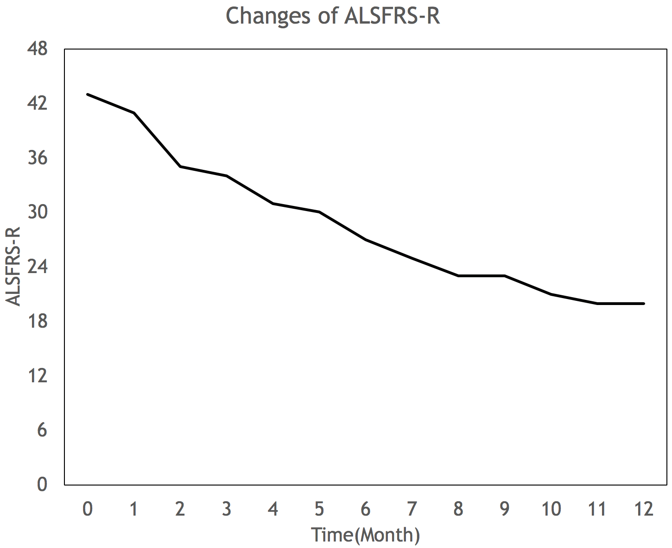
Problem Statement
To be predicted
Goal: To predict functional decline in ALS at a given time.

Slide 5

Data Preprocessing
Data Collection
Data Preparation

Slide 6
Data Collection
PRO_ACT: a website provides user with easy access to over 10700 fully de-identified clinical patient records.
Baseline data: 10729 rows * 74 cols
Endpoint data: 66407 rows * 3 cols
pid | Age | Gender | Onset | alsfrs_r_total_bl | ...
1 | 40 | 0 | limb | 46 | ...
2 | 30 | 1 | bulbar | 24 | ...
pid | t | ALSFRS-R
1 | 0 | 46
1 | 20 | 44
1 | 67 | 42
2 | 0 | 24
2 | 34 | 21
alsfrs_r_total_bl: alsfrs_r score at baseline level.

Slide 7
Data Preparation
Merged data: 66407 rows * 77 columns.
pid | Age | Gender | onset | VC | ... | t | ALSFRS_R
1 | 40 | 0 | limb | 0.01 | ... | 0 | 46
1 | 40 | 0 | limb | 0.01 | ... | 20 | 44
1 | 40 | 0 | limb | 0.01 | ... | 67 | 42
2 | 30 | 1 | bulbar | 0.03 | ... | 0 | 24
2 | 30 | 1 | bulbar | 0.03 | ... | 34 | 21
The only changeable feature is t.

Slide 8
Data Preparation
Create several features: Month, onset_age …
Data dimension: 30236 rows * 74 cols
Response variable missing | Delete record
Feature has over 20% missing value | Delete feature
Continuous feature with missing value | Fill in with median value
Categorical feature with missing value | Fill in with most frequent level

Slide 9

Exploratory Analysis

Slide 10
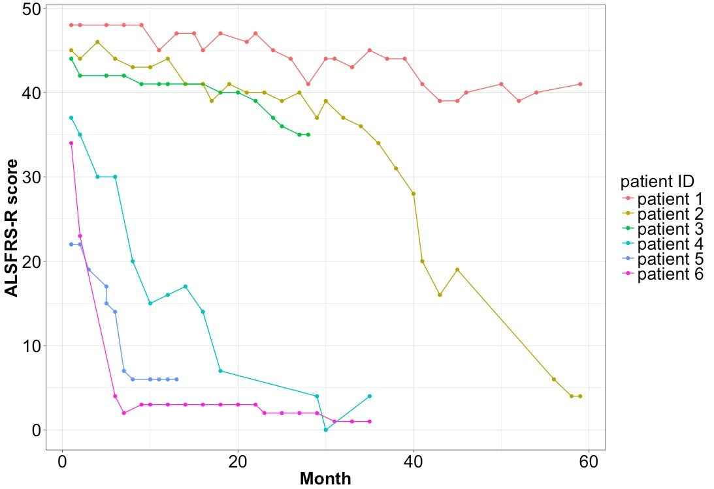
Exploratory Analysis
6 Cases of ALSFRS-R score and month

Slide 11
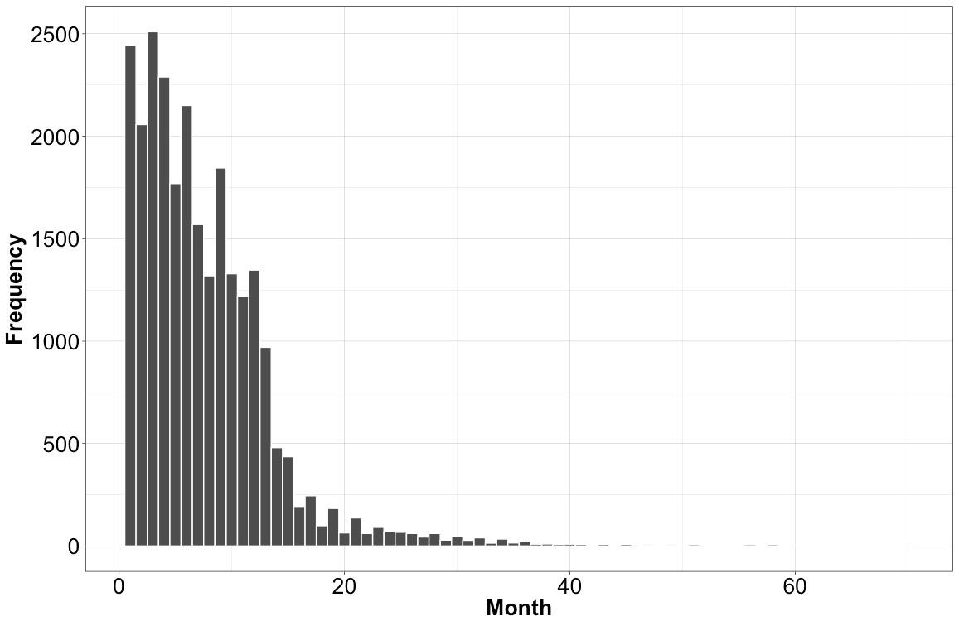
Exploratory Analysis
Frequency of visits along time
mean | std | min | 25% | 50% | 75% | max
32.65 | 9.02 | 0.00 | 27.00 | 34.00 | 39.00 | 48.00

Slide 12
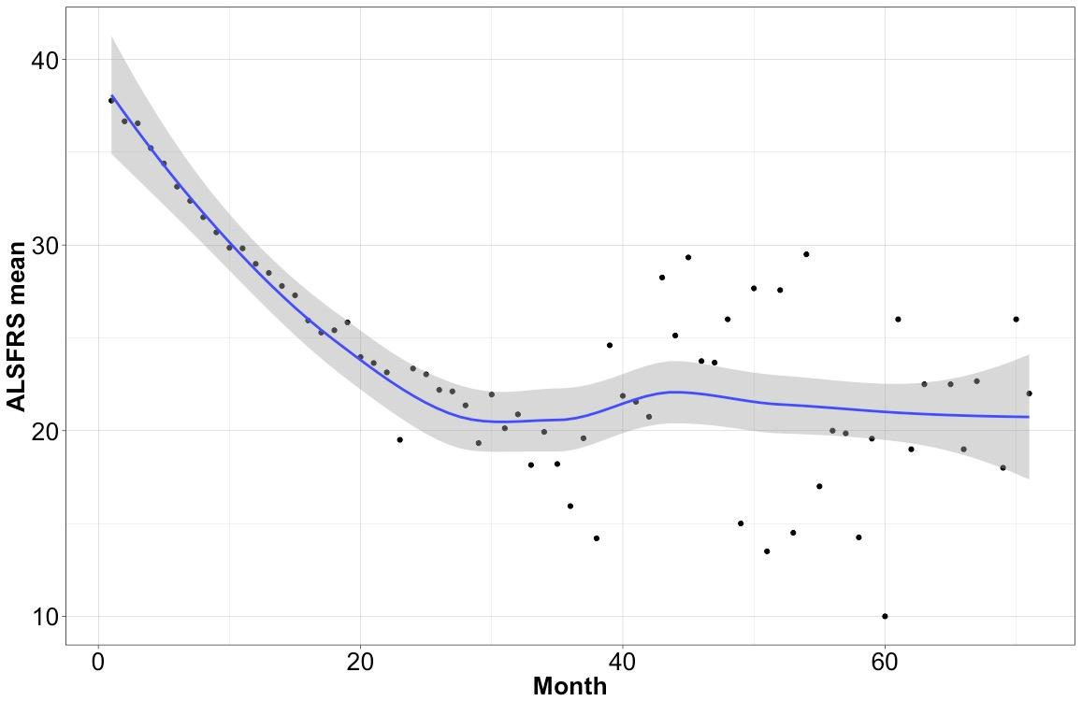
Exploratory Analysis
Distribution of mean of ALSFRS-R score with time

Slide 13
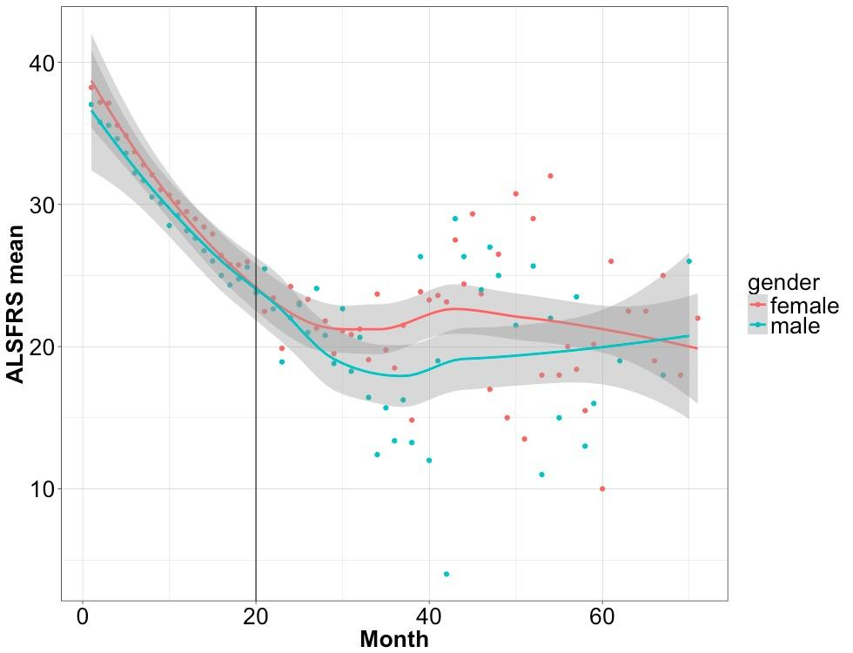
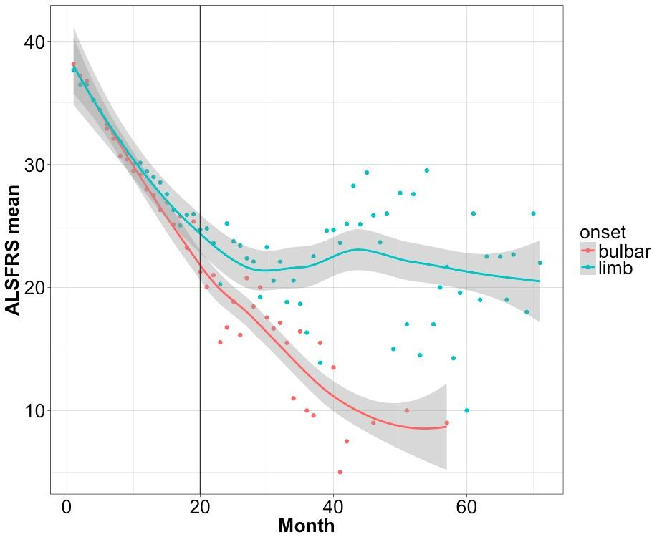
Exploratory Analysis
Gender distribution with month
Time series of limb and bulbar

Slide 14

Modeling
Model Selection
Tree-based Model
Neural Network
Weighted Ensemble

Slide 15
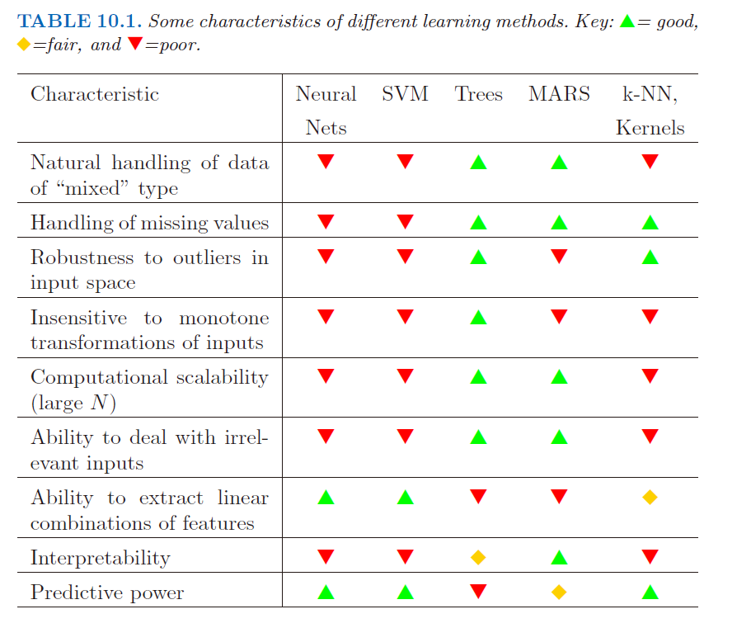
Model Selection
Rationales:
Mixed data
Missing values
Outliers
Feature ‘t’
Selection Models:
Tree-based Model
Neural network
Source: The Elements of Statistical Learning, p351

Slide 16
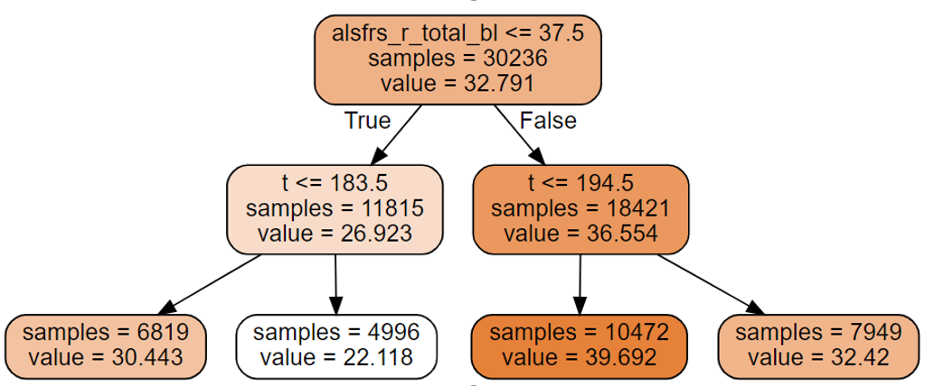
Tree-based Model: LightGBM & XGBoost
Single Decision Tree

Slide 17
Tree-based Model: LightGBM & XGBoost
Boosting Method
Base Classifier
Learning
Weight
residuals
Base Classifier
Learning
Weight
Result
residuals
Base Classifier
Learning
Weight

Slide 18
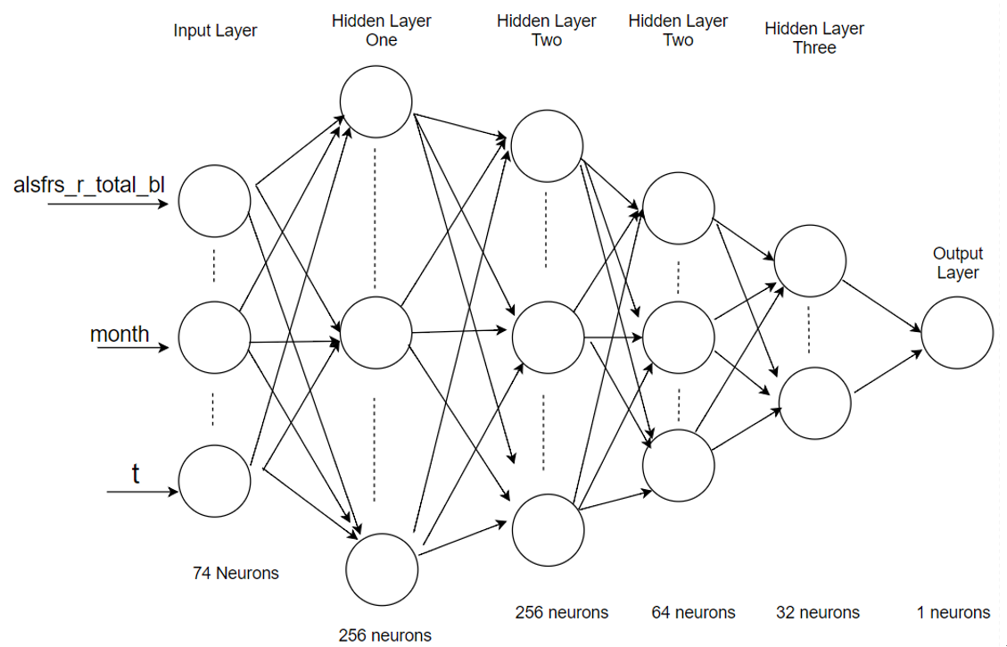
Deep Neural Network
Six Layers(input/output)
Fully connected layers
Input/output Layer
Linear Combination
Activation function: ReLU
Dropout for each layer
Optimizer Method: Adam
Framework

Slide 19
Weighted Ensemble
LightGBM
10-fold CV
Prediction1
W1(60%)
XGBoost
10-fold CV
Prediction2
W2(30%)
Final Result
Neural Netwrok
10-fold CV
Prediction3
W3(10%)

Slide 20

Result
Internal Validation
Bias analysis
External validity

Slide 21
Result – Internal Validation
For the whole period(~ 70 months)
Linear Regression for Observed vs. Predicted Value
 | XGB | LGB | DNN | Weighted Ensemble
R² | 0.702 | 0.704 | 0.606 | 0.706
RMSE | 4.896 | 4.882 | 5.631 | 4.864
Slope | 0.988 | 1.001 | 0.946 | 1.009
Intercept | 0.460 | 0.025 | 2.246 | -0.194
Skewness | -0.537 | -0.522 | 2.194 | -0.468

Slide 22
Result – Internal Validation
Most of the data falls in the first 20 months
In reality, the prediction of the first 1 year means a lot.
Whether our models perform better in the first one year?

Slide 23
Result – Internal Validation
For the first one year (~12 months)
 | XGB | LGB | DNN | Weighted Ensemble
R² | 0.724(⬆️3.13%) | 0.725(⬆️2.98%) | 0.589(⬇️2.81%) | 0.727(⬆️2.97%)
RMSE | 4.214(⬇️13.93%) | 4.206(⬇️13.85%) | 5.140(⬆️8.72%) | 4.190(⬇️13.86%)
Intercept | 0.337 | 0.051 | 4.902 | -0.049
Slope | 0.991 | 1.000 | 0.874 | 1.005
Skewness | -0.538 | -0.556 | 2.769 | -0.488

Slide 24
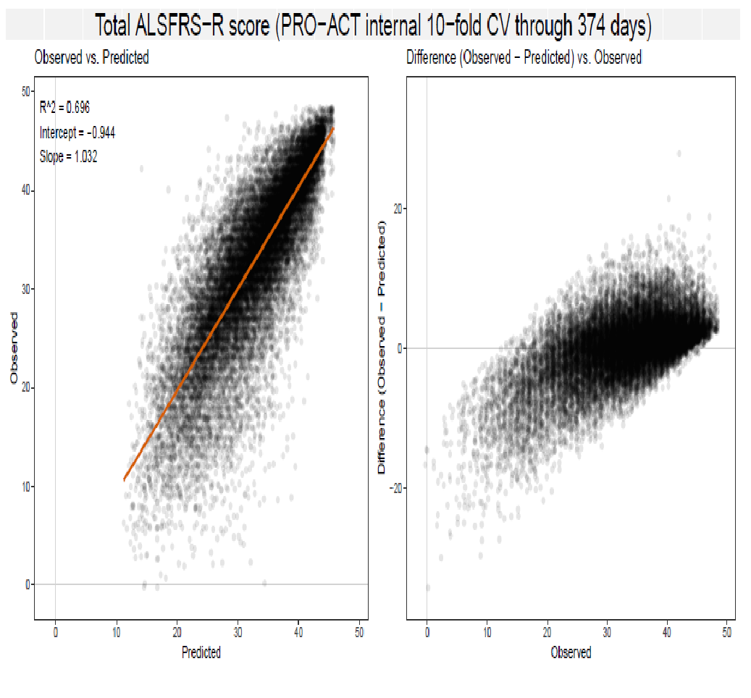
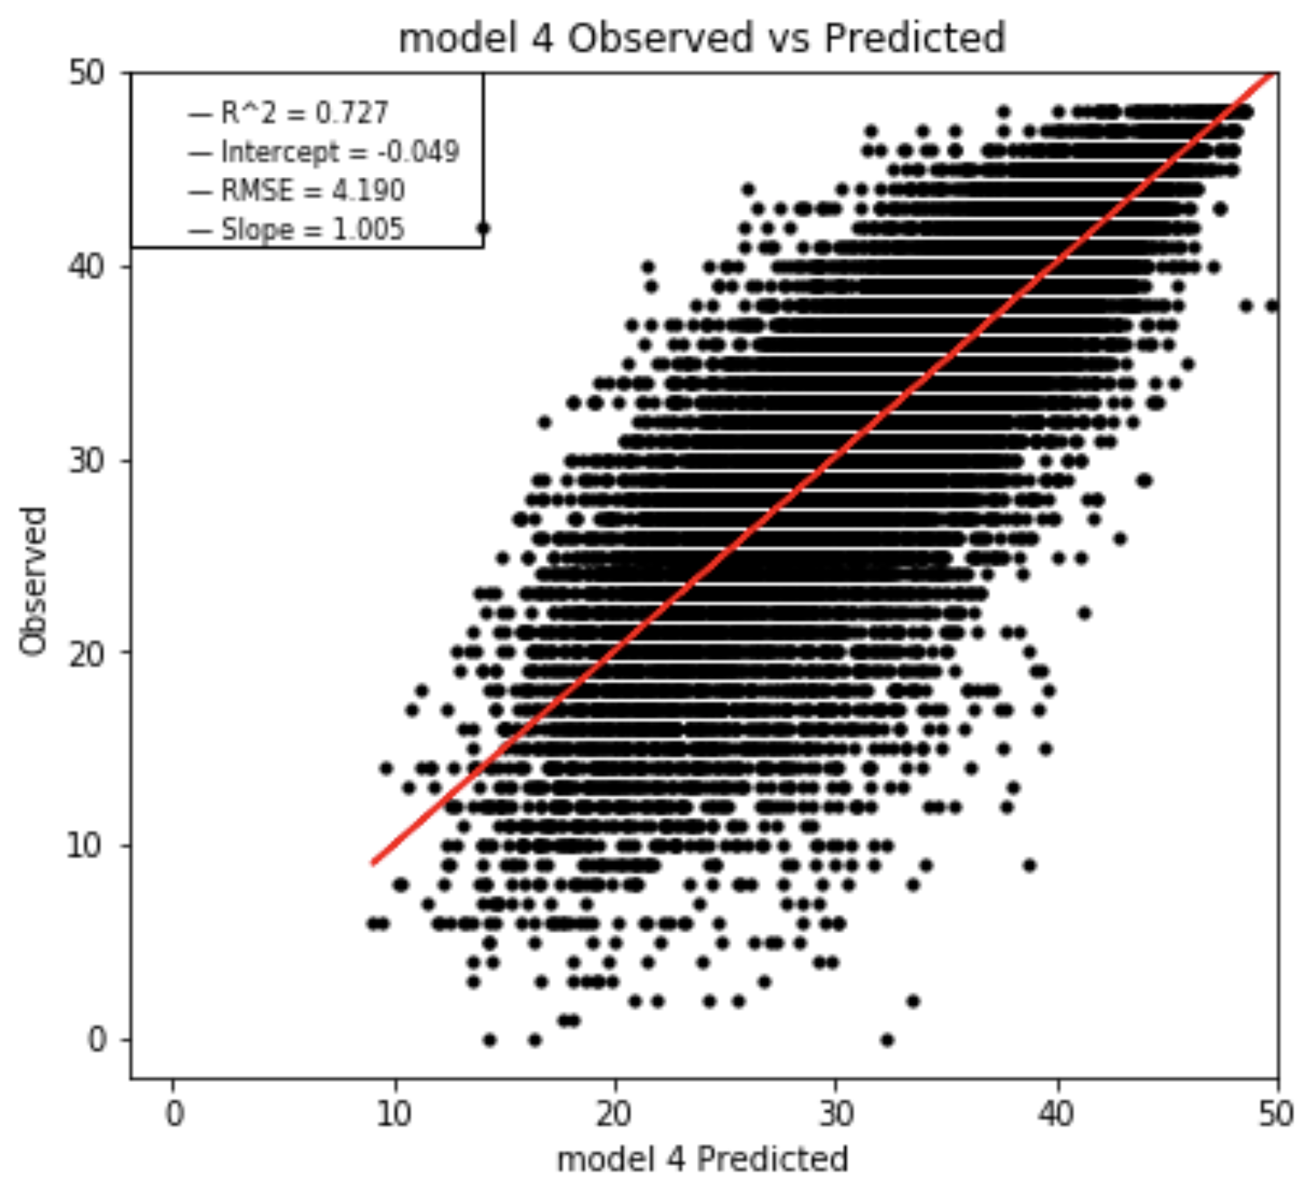
Result – Internal Validation
Compared with the previous work(for the first1 year)
Weighted Ensemble: Observed vs. Predicted
Predicted

Slide 25
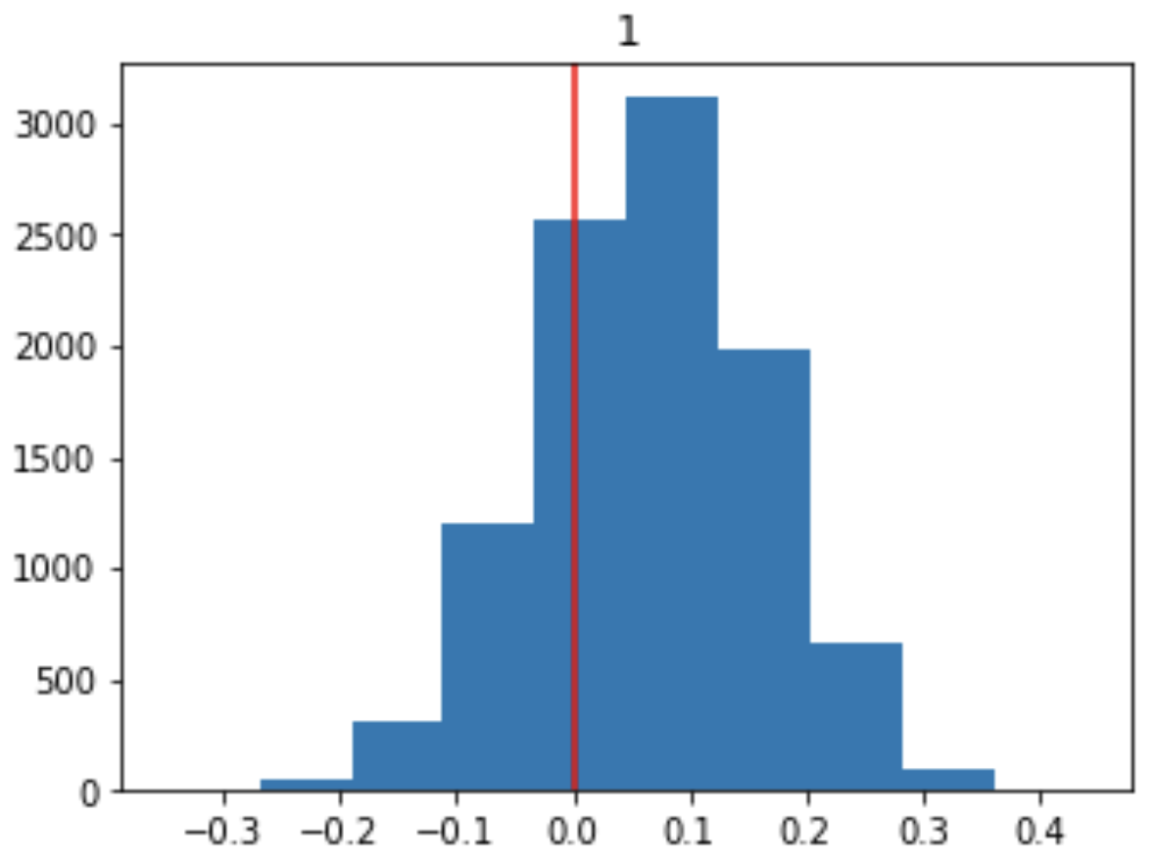
Result – Bias Analysis
People pay more attention to the disease development by month
Mean Prediction Error = Observed Value – Predicted Value
Month 1
Bootstrap 10000 times
95% Confidence Interval
(CLT)
Frequency
Mean prediction error

Slide 26
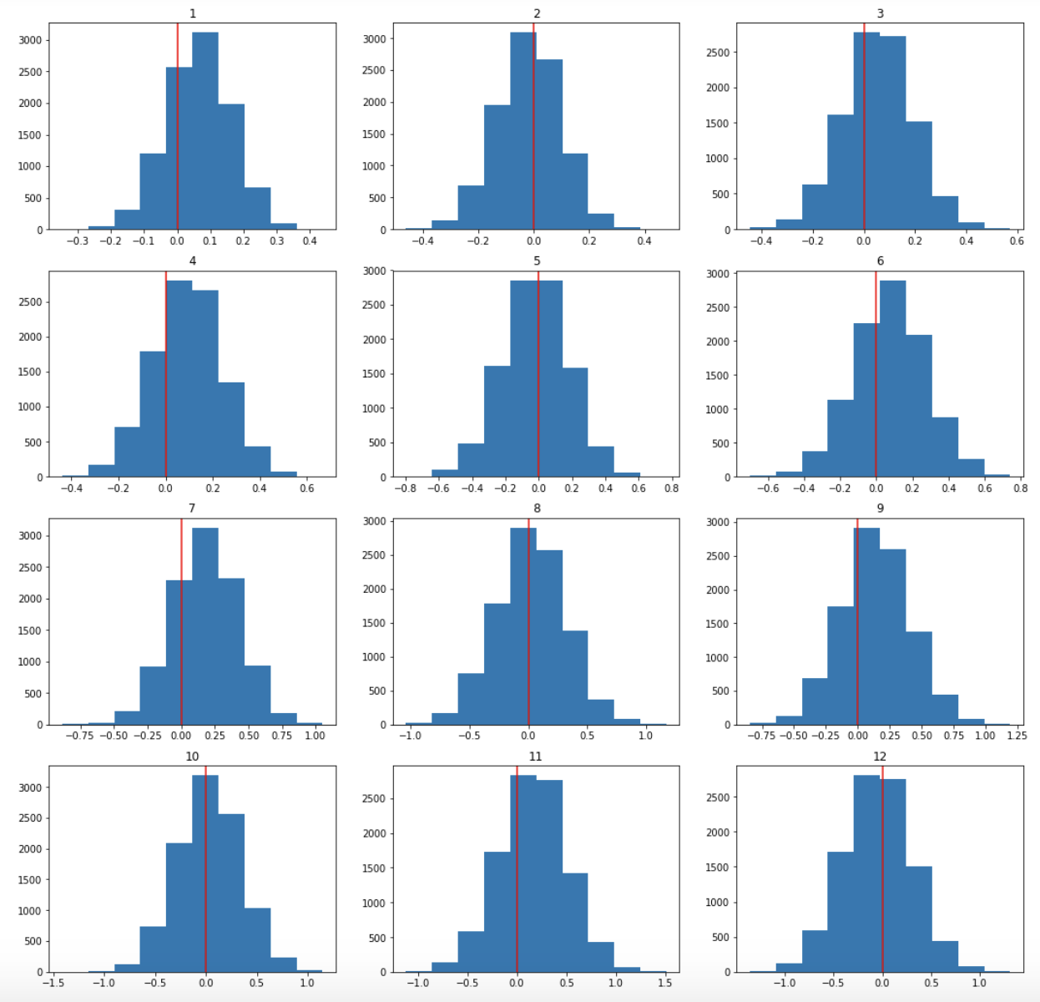
Result – Bias Analysis
Mean Prediction Error Plot for the first 12 months

Slide 27
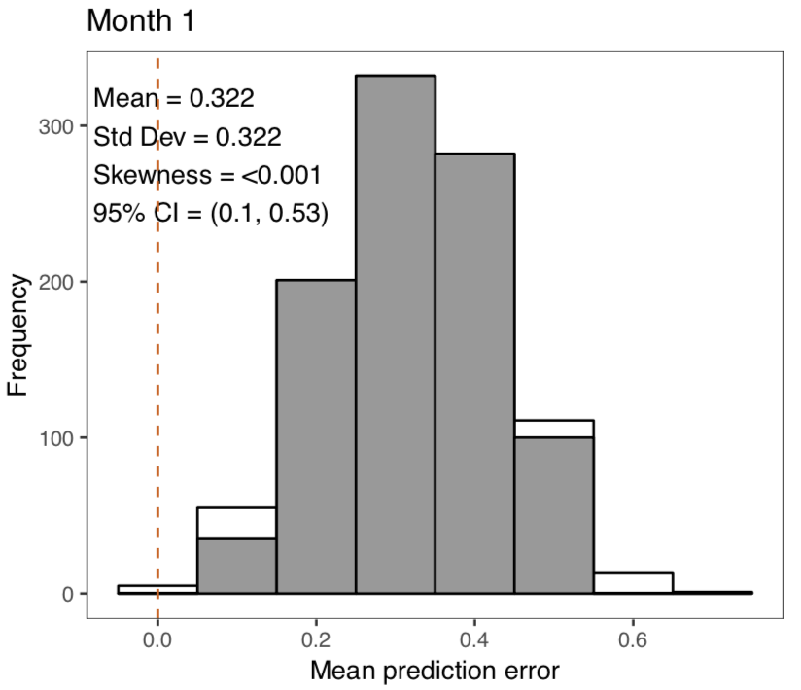
Result – bias analysis
Compared with the previous work
Month 1
Frequency
Mean prediction error

Slide 28
Result – External Validation
External test data(1538 records for the first 15 months)
( < 15 month) validation of model performance
 | Internal Validation (sub-dataset: 15 months) | External Validation (full data: 15 months)
N | 28127 | 1538
R² | 0.713 | 0.717
RMSE | 4.486 | 4.560

Slide 29

Conclusion
Created a collection models trained to predict ALSFRS-R at a wide range of time points
Improved the prediction power for the first one year, the best R² is 0.727
Built package containing seven functions to evaluate the different models in Python

Slide 30
Next Steps
Before final report
Fully implement package.
In the future
Gather more records.

Slide 31
Acknowledgement
We give special thank to Dr. Ennist, Dr. Taylor, and Mr. Conklin for project opportunity as well as technical support. We also thank Dr. Anand and Eric Wang for suggestions on plots and models.
Reference
Gareth James, Daniela Witten, Trevor Hastie, Robert Tibshirani. An Introduction to Statistical Learning : with Applications in R. New York :Springer, 2013. Print.
“Interpretation Guides to Standardized Questionnaires Employed in the ALS CARE Database, Including the:” ALS SF-12, ALSFRS Interpretation Guides, www.outcomes-umassmed.org/als/sf12.aspx.
PRO‐ACT. Pooled resource open‐access als clinical trials database. https://nctu.partners.org/ProACT/ (Accessed February 21, 2015)

Slide 32

Question?

